Slide 1



MIS FOR
SMART CLASS IMPLEMENTATION
© Copyright SOUL LIMITED

Slide 2









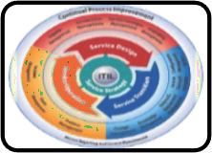


ABOUT SOUL LIMITED
SOUL Limited is the sister concern of KIIT’s which executes Strategy Consulting for Business transformation focused on sustainability through operational efficiency and capital productivity; using delivery process realignment, skill restructuring, smart negotiation, and contracting.
Our Insights:
Smart campus solutions using IoT and AI
Skilled human resources for operation and maintenance of solar appliances
Deployment of Enterprise Applications for
governance of University
Sustainable engagement in core strategy,
operational and technical development
Design and deployment of education aids
IT infrastructures support to organizations as per ITIL standards
Sustainable Healthcare, Modernizing Agriculture, Skill development in manufacturing, Disability Cluster
Robotics-Aiding institutions with humanoids for contactless services
© Copyright SOUL LIMITED

Slide 3










INTRODUCTION TO SOUL
CERTIFICATION
MSME certified micro industry with UDYAM Registration No.-
UDYAM-OD-19-008646
Energy & Smart Infrastructure
Education
ISO Certified – ISO 9001:2015, ISO/IEC 20000-1:2018, ISO/IEC 27001:2013 & ISO 14001:2015
Meaningful and sustainable solutions
Skill
Development
IT & ITES
EMPANELMENT
Broadcast Engineers Consultants India Limited
Health and Social Wellness
Agriculture
Bharat Sanchar Nigam Limited
Rural Development
Partnership
© Copyright SOUL LIMITED

Slide 4









KIIT - THE LEADER IN EDUCATION
90+
Projects
India’s first QS 5 Stars Rated University
No 1 among the private higher education Indian Universities
1921+
Publications
21st in India Rankings by NIRF
2500
Researchers
SOUL will leverage skillsets and research outcomes to build world class products and services for its distinguished clients
30K
Students
© Copyright SOUL LIMITED
Notes:
2500 researchers
30 K students

Slide 5

KIIT - SOUL ASSOCIATION
SOUL as the associate consultant of KIIT
SOUL is authored with the rights to use the financial and experiential credentials of KIIT
KIIT and SOUL
share financial gains for the executed projects
KIIT=SOUL
SOUL can deploy the faculties, research scholars
, ground staff of KIIT as its own resource
© Copyright SOUL LIMITED

Slide 6














MIS: SMART CLASS IMPLEMENTATION
School Master
Survey
Electricity Consumption record
Internet Consumption record
Equipment Uptime record
School-Wise Equipment List
Teachers
Teacher Group
School Consent form for Teacher Training
Teacher Training
Items Master
Theft Case record
Reports & Dashboard
Support
© Copyright SOUL LIMITED

Slide 7
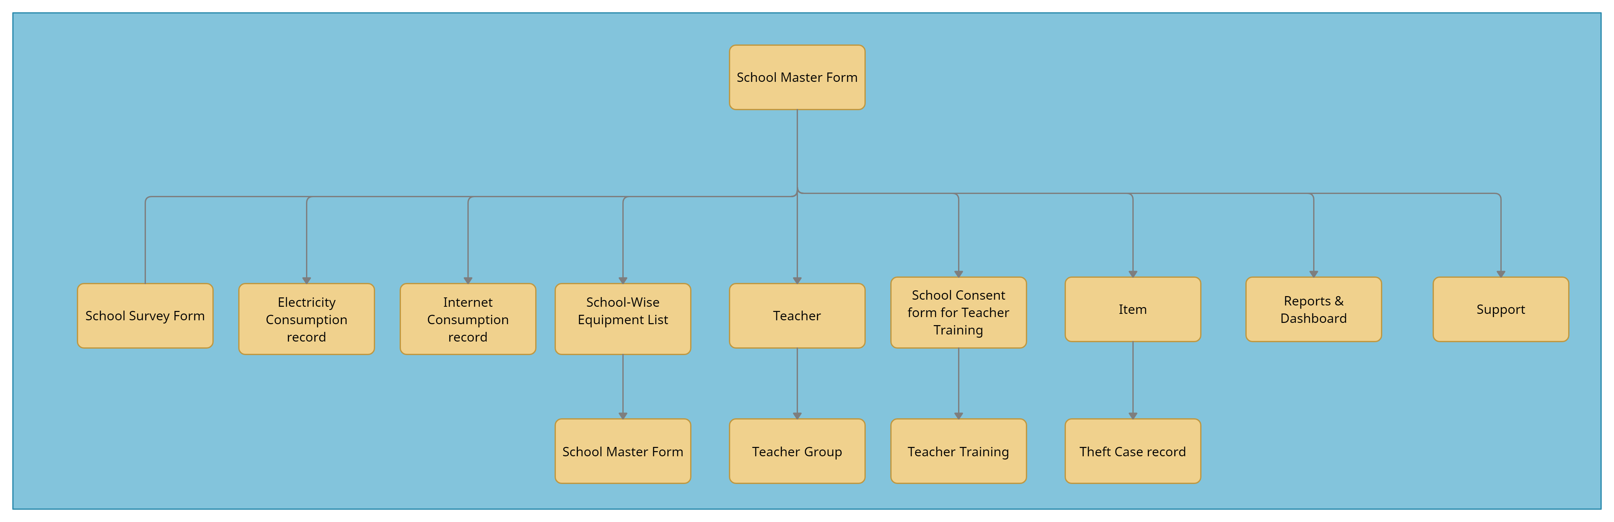
APPLICATION FLOW (SCHOOL TRANSACTIONS)
© Copyright SOUL LIMITED

Slide 8
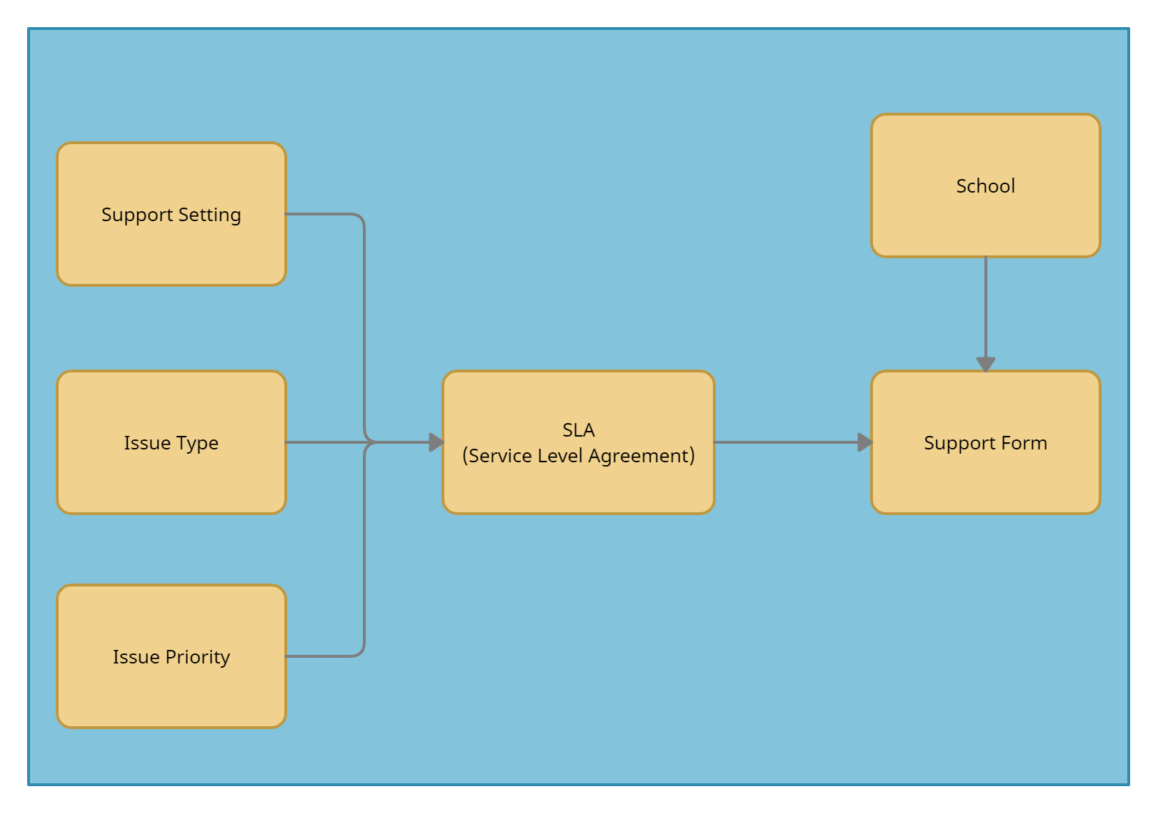
APPLICATION FLOW (SUPPORT PROCESS)
© Copyright SOUL LIMITED

Slide 9
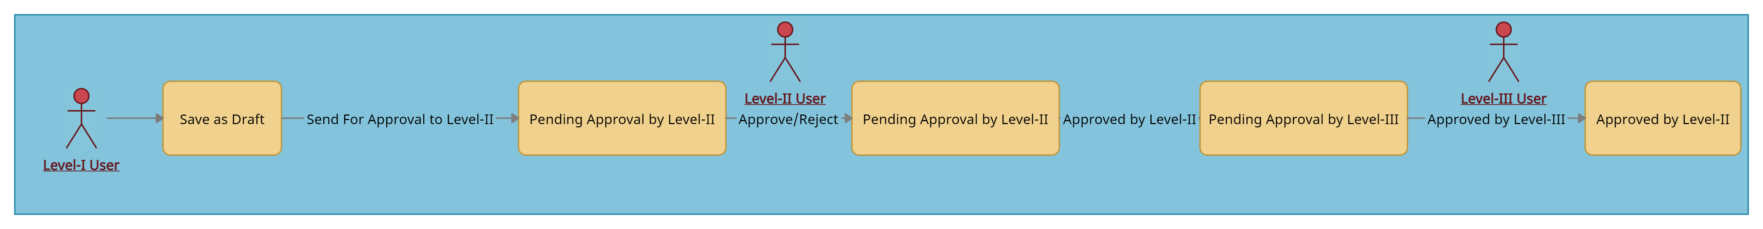
SCHOOL AND SURVEY FORM - WORKFLOW
© Copyright SOUL LIMITED

Slide 10
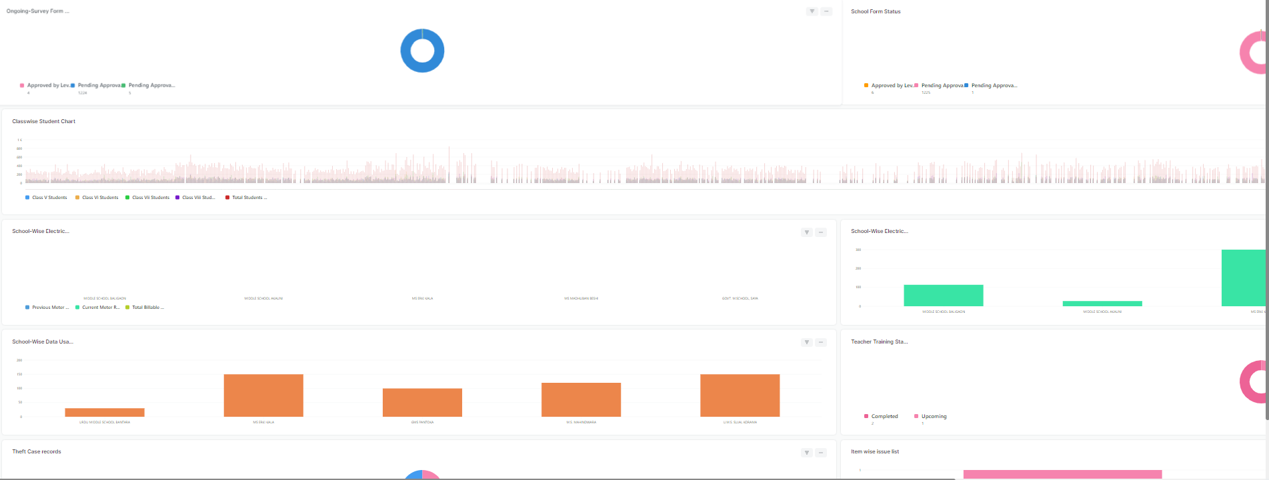
DASHBOARD
Visual display of data such as Electricity consumption, Internet consumption, Teacher training, etc for Management
© Copyright SOUL LIMITED

Slide 11
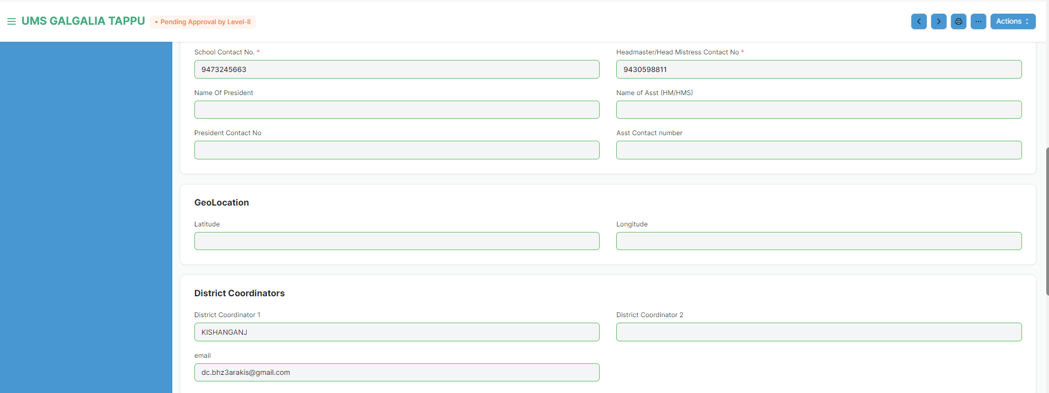
SCHOOL MASTER DATA
Recording and Maintaining School details such as District, Block, Zone, Contact , Head Master Name, Mail ID
© Copyright SOUL LIMITED

Slide 12
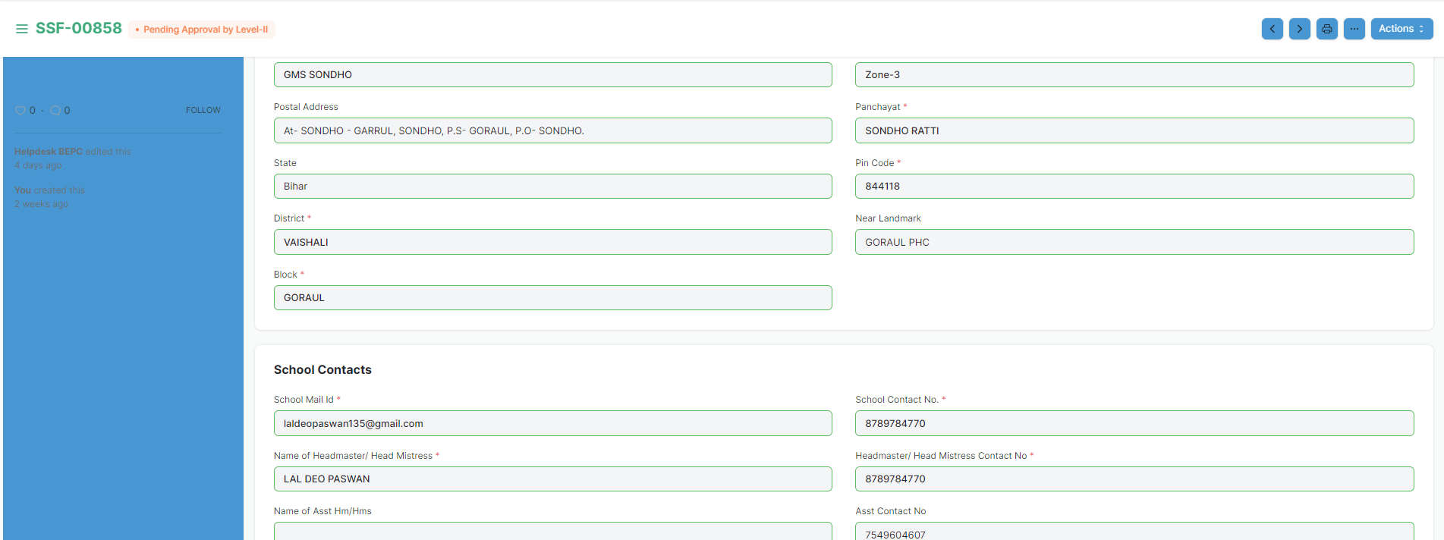
SCHOOL SURVEY FORM
Gathering and Recording information such as Class wise students, Total boys / girls, Students category (SC, ST, OBC), Infrastructure, Route, Lab details for a school
© Copyright SOUL LIMITED

Slide 13
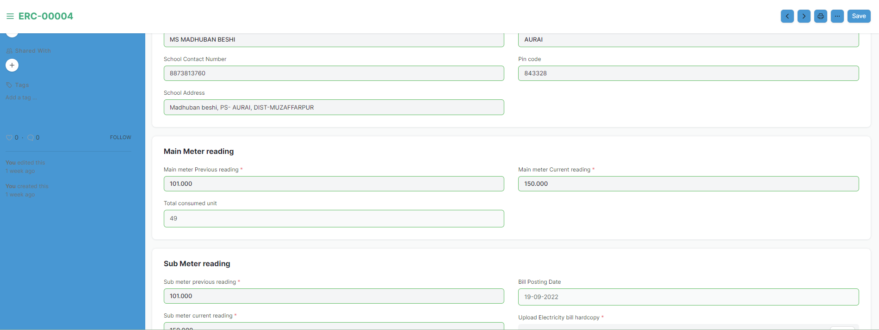
ELECTRICITY CONSUMPTION RECORD
Records the Electricity consumption information such as current meter reading, consumed unit, electricity bill date with a provision to attach hard copy of electricity bill for a particular school
© Copyright SOUL LIMITED

Slide 14
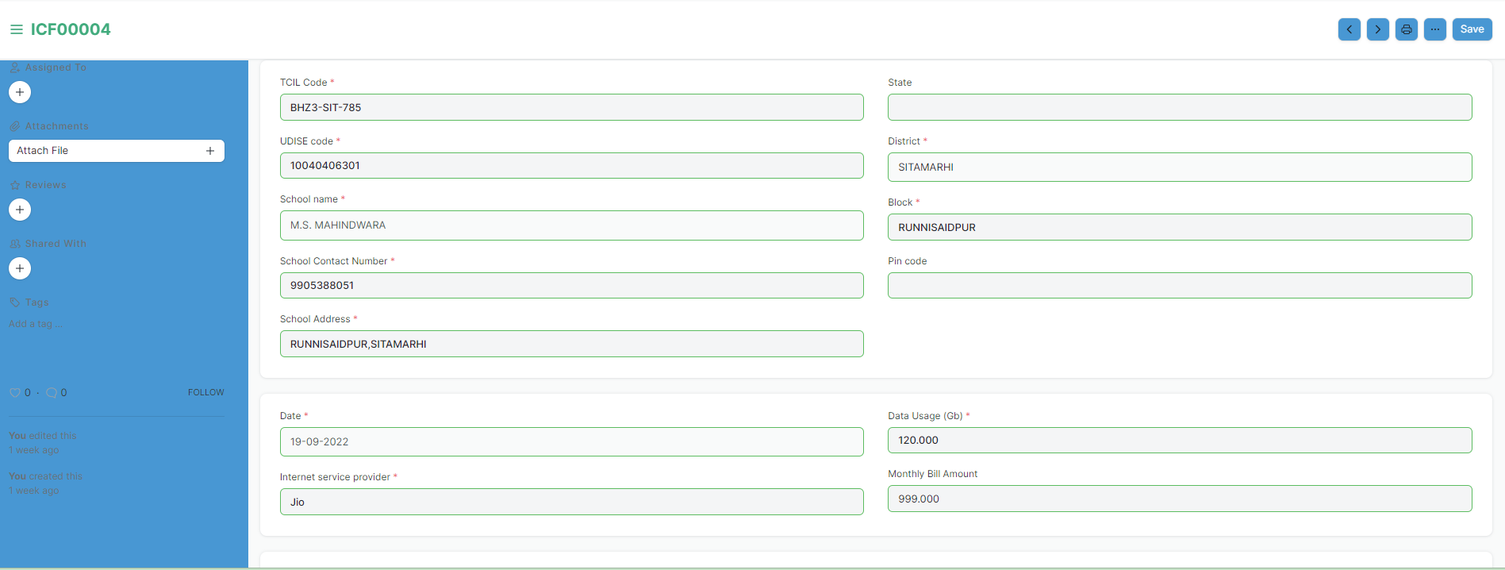
INTERNET CONSUMPTION RECORD
Records the Internet consumption information such as Internet Service Provider, data usage, bill amount, bill date for a school
© Copyright SOUL LIMITED

Slide 15
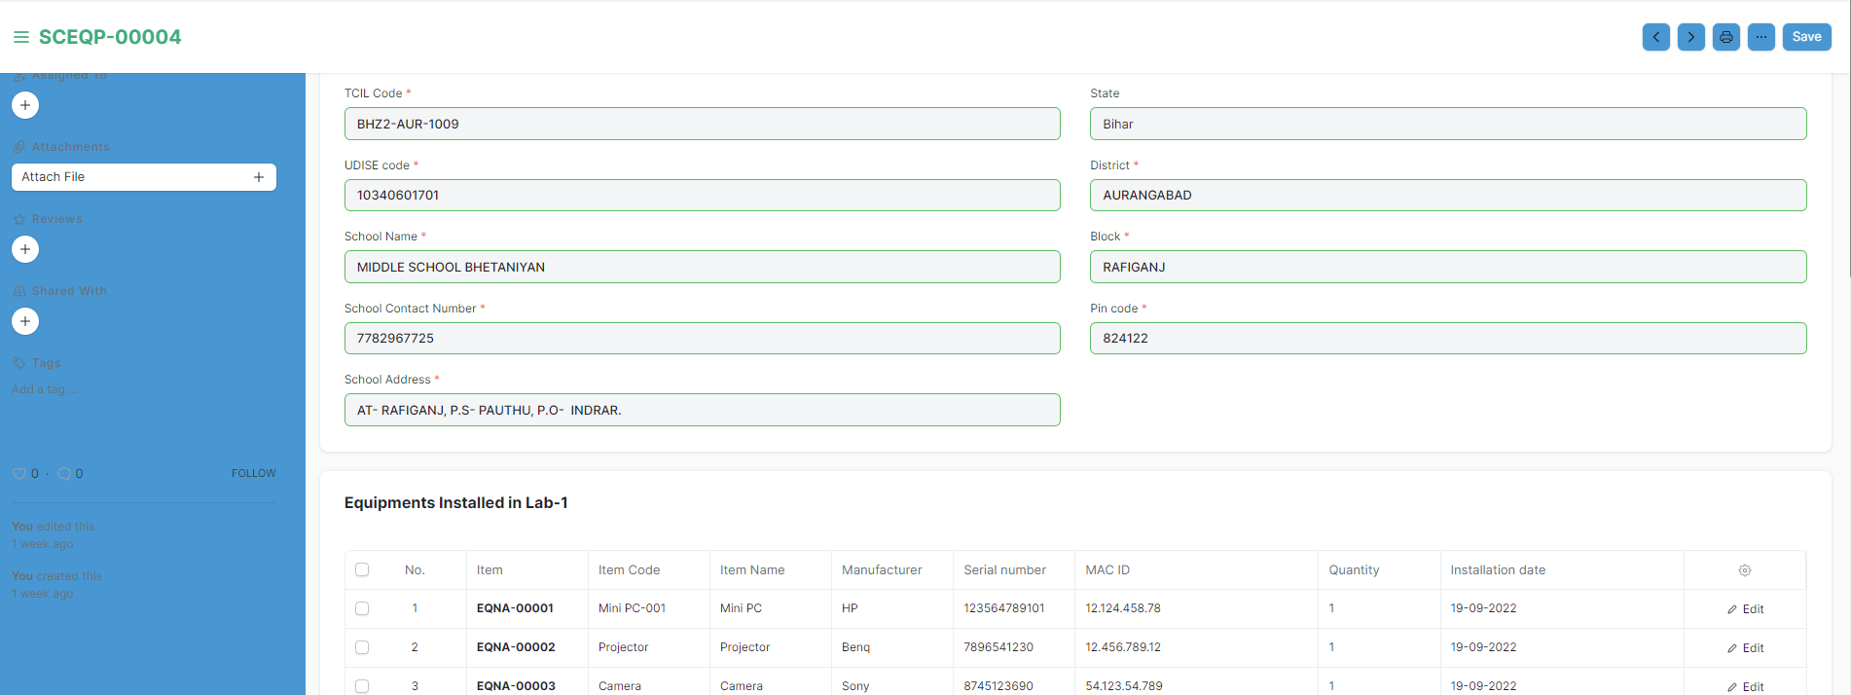
SCHOOL EQUIPMENT LIST
Maintaining the list of all equipment installed in the lab of a school. For e.g. Projector, Mini PC, Speaker
© Copyright SOUL LIMITED

Slide 16
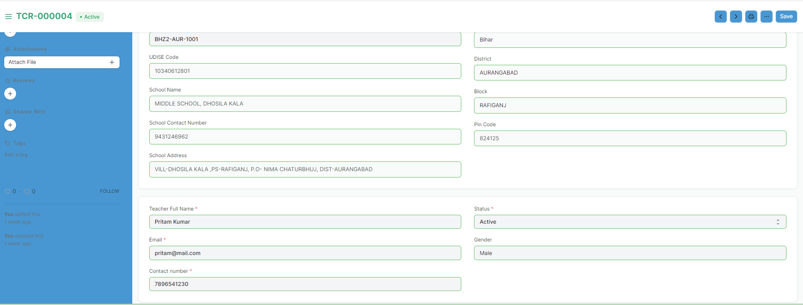
TEACHER
Teacher profile details for a school
© Copyright SOUL LIMITED

Slide 17
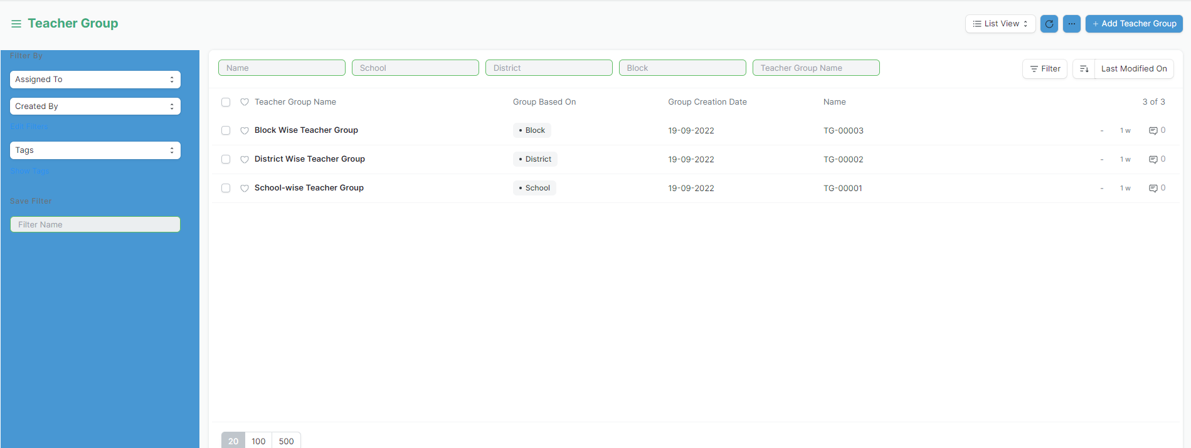
TEACHER GROUP
Grouping of teachers based on Block, District and School
© Copyright SOUL LIMITED

Slide 18
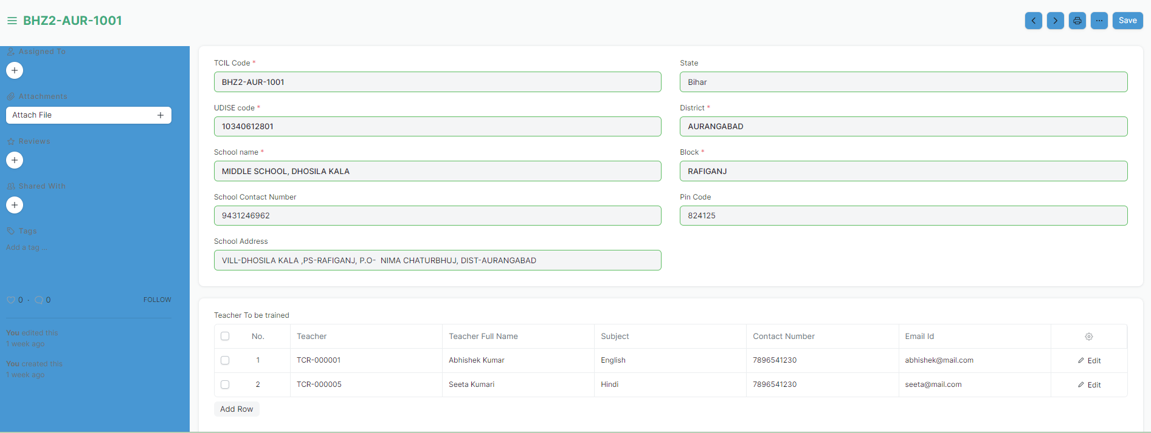
SCHOOL CONSENT FOR TEACHER TRAINING
The consent form of a school listing the teachers to be trained during the Teachers Training Programme
© Copyright SOUL LIMITED

Slide 19
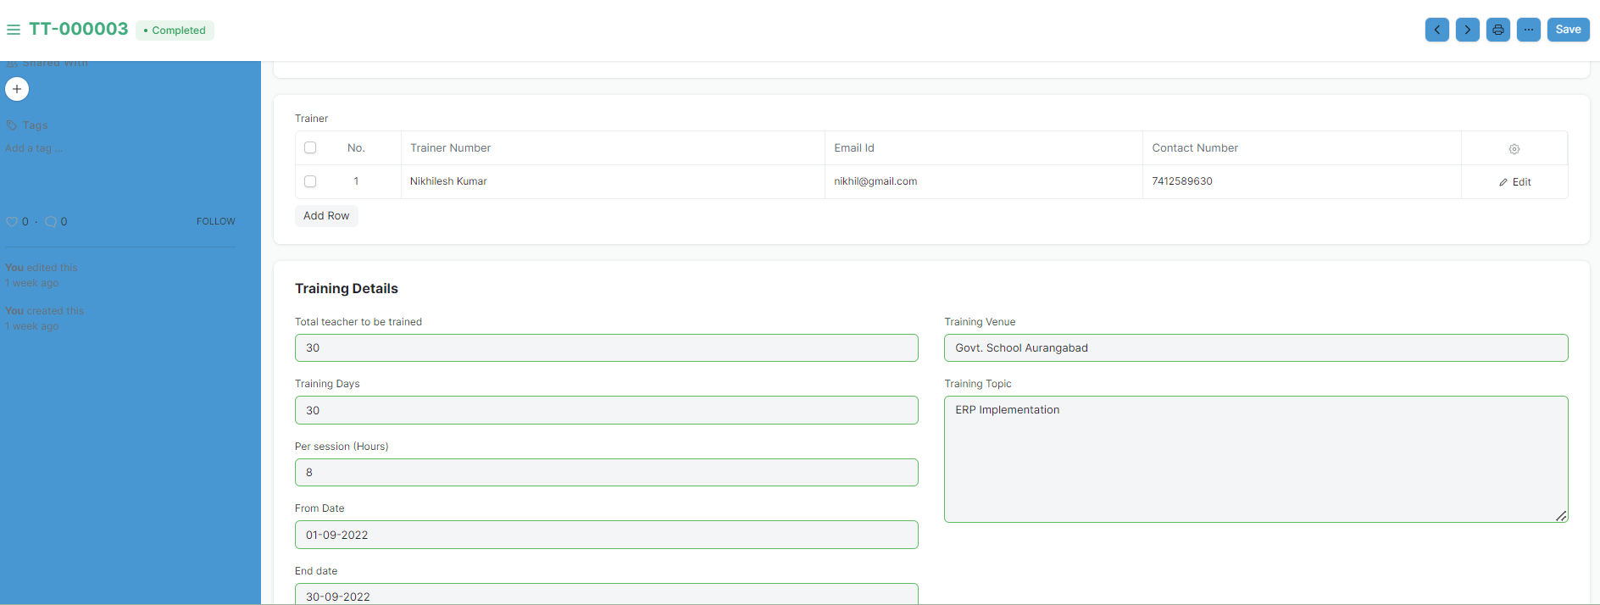
TEACHER TRAINING
Maintaining the training details such as Trainer, Training Venue, Date, Per Session (Hrs), Topic for the school's Teacher Training Programme
© Copyright SOUL LIMITED

Slide 20
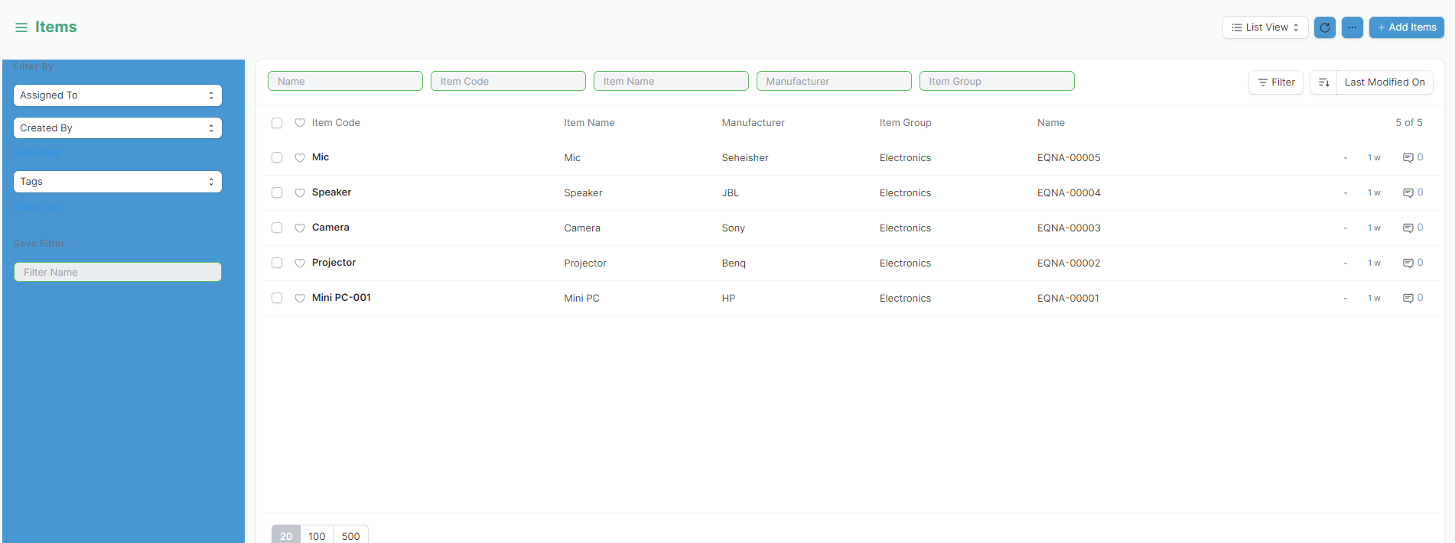
ITEMS
Maintaining the list of Items (Equipment) installed in the school
© Copyright SOUL LIMITED

Slide 21
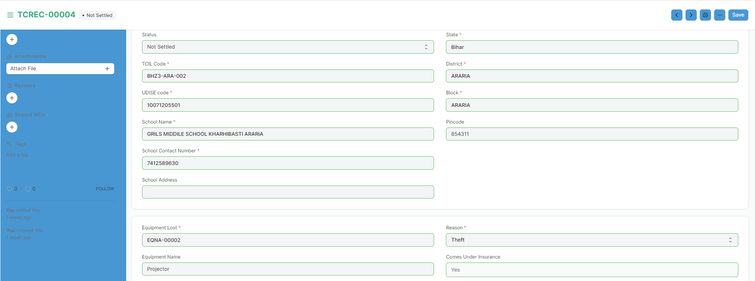
THEFT CASE RECORD
Recording and Maintaining details such as Item lost, FIR copy, NTR copy when an Item / Equipment is lost from the school
© Copyright SOUL LIMITED

Slide 22
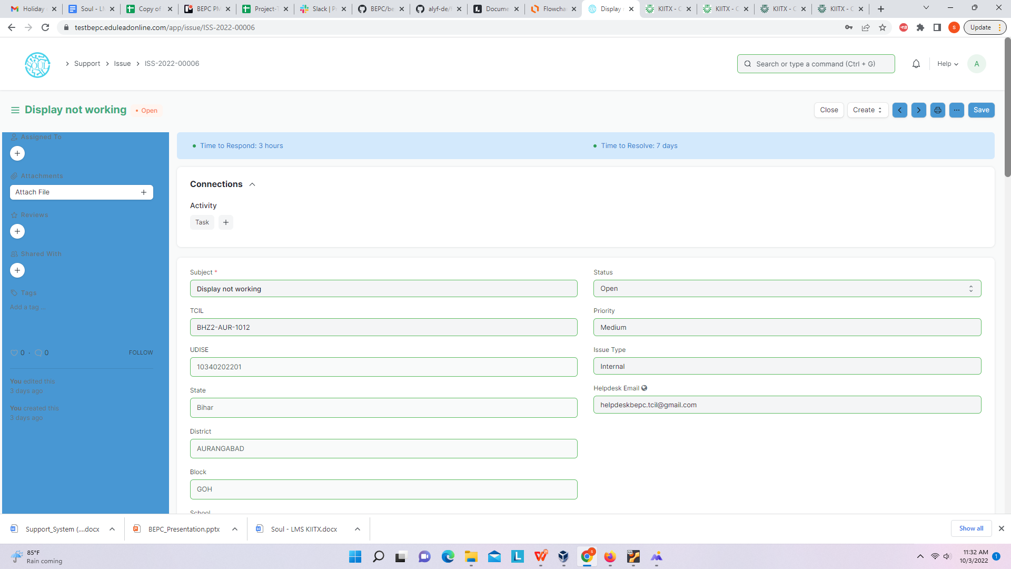
ISSUE
An Issue is query from a Customer to the Help-desk. Complaint is is lodged with details such as School, Issue type, Priority, Email ID, etc
© Copyright SOUL LIMITED

Slide 23
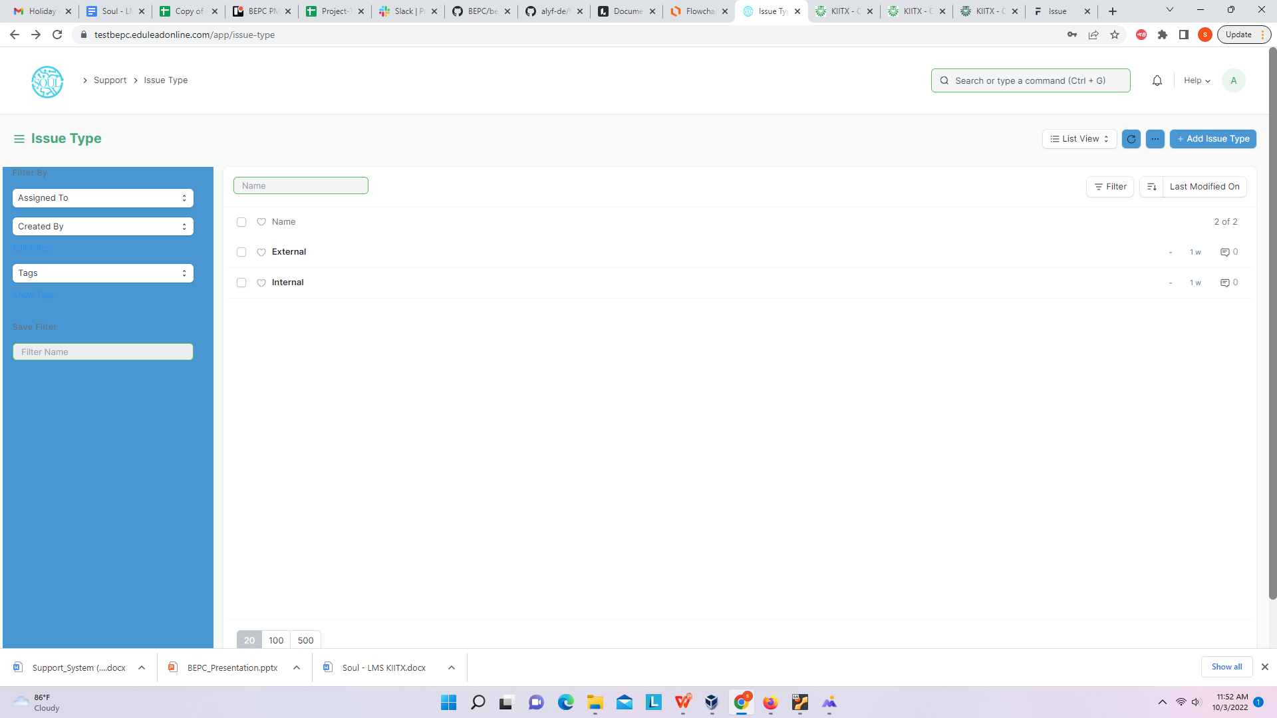
ISSUE TYPE
Issue Type is for tagging and classifying Issues. For e.g. External, Internal, Functional, Technical, Hardware
© Copyright SOUL LIMITED

Slide 24

ISSUE PRIORITY
Issue Priority can be set as per the requirements such as Low, Medium, and High.
© Copyright SOUL LIMITED

Slide 25
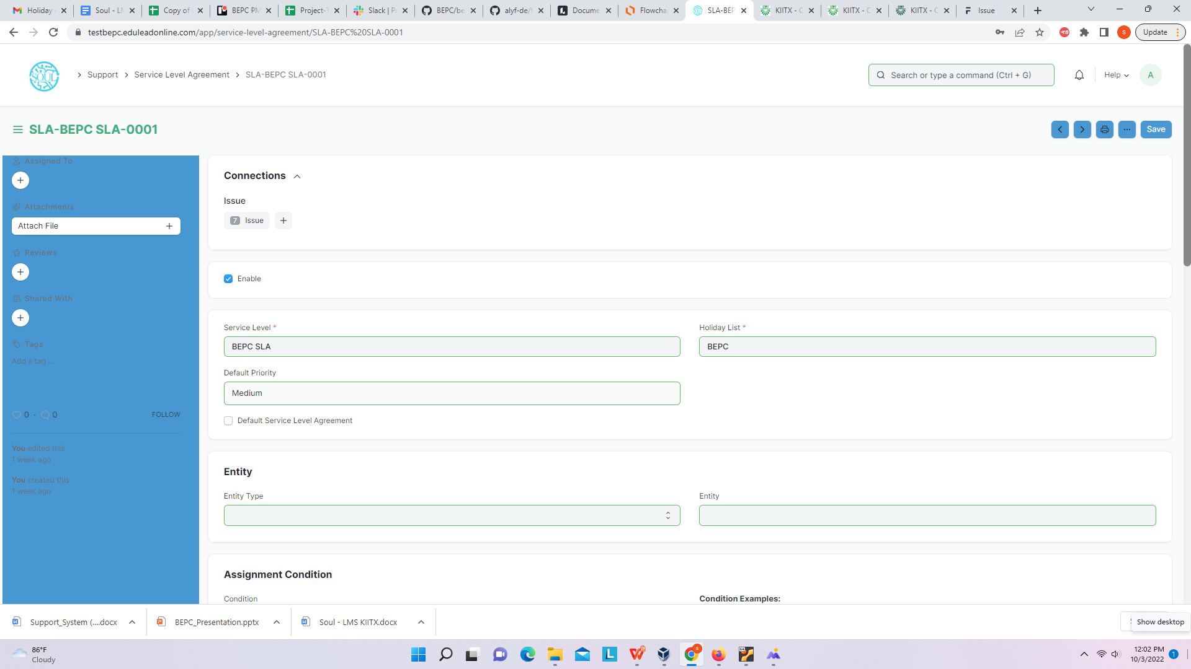
SERVICE LEVEL AGREEMENT
A service level agreement (SLA) is a contract between the service provider and the end user on the level of service expected from the service provider.SLAs are output-based, their purpose is specifically to define the timeline in which the Customer will receive the service.
© Copyright SOUL LIMITED

Slide 26
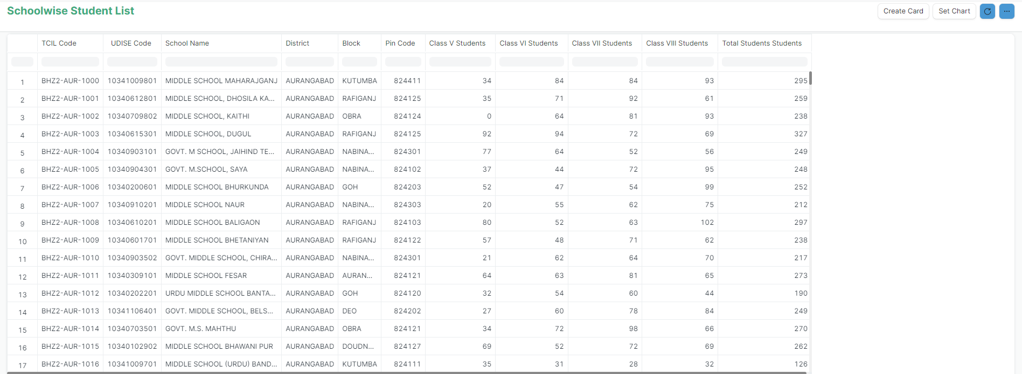
SCHOOLWISE STUDENT LIST - REPORT
Report view of class categories and no. of students per class
© Copyright SOUL LIMITED

Slide 27
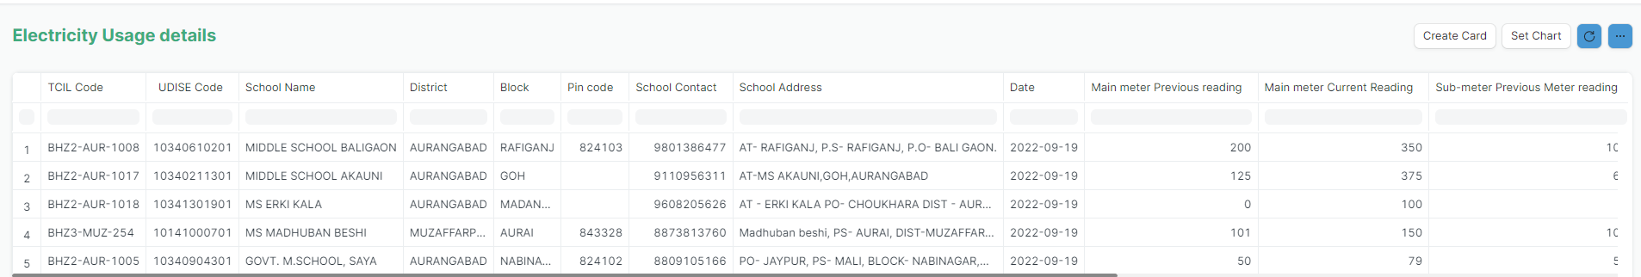
ELECTRICITY USAGE - REPORT
Report view of Electricity usage (consumption) details school wise
© Copyright SOUL LIMITED

Slide 28
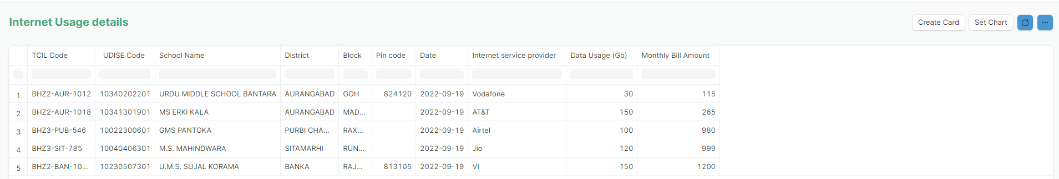
INTERNET USAGE - REPORT
Report view of Internet usage (consumption) details school wise
© Copyright SOUL LIMITED

Slide 29
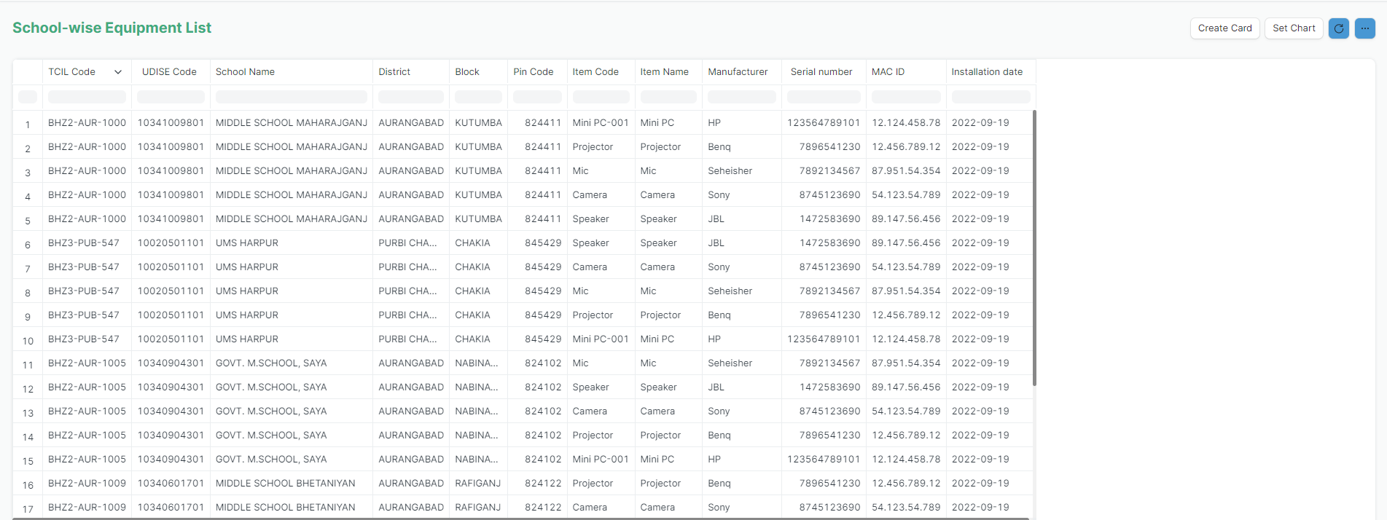
SCHOOL WISE EQUIPMENT - REPORT
Report view of equipment (items) detail installed in a school
© Copyright SOUL LIMITED

Slide 30
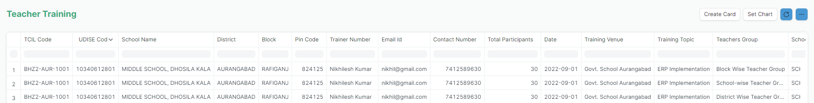
TEACHER TRAINING - REPORT
Report view of Teachers Training Programme
© Copyright SOUL LIMITED

Slide 31
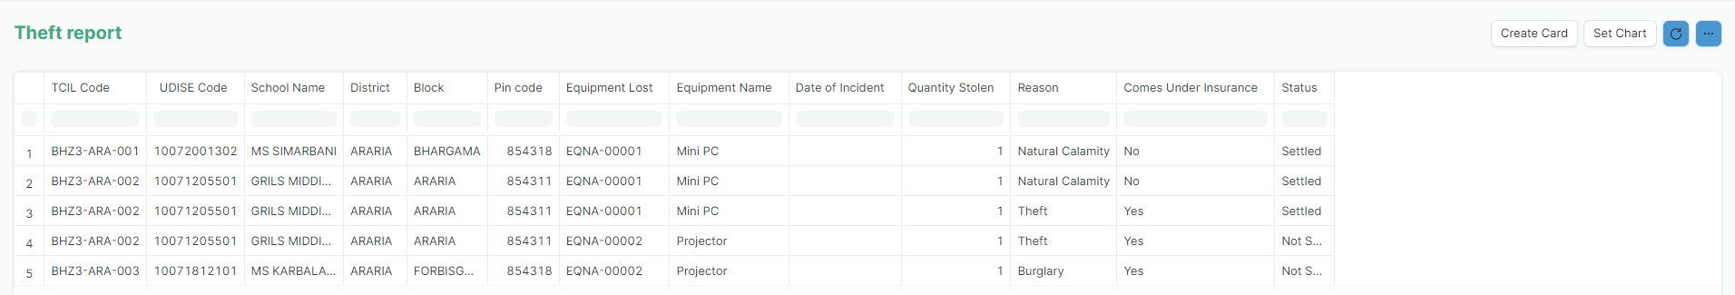
THEFT - REPORT
Report view of Items (Equipment) lost in a school
© Copyright SOUL LIMITED

Slide 32

THANK YOU

